Slide 1


Preliminary KEfED Annotations for Reading
Gully APC Burns

Slide 2
The ‘Cycle of Scientific Investigation’ Model
Cycles of Scientific Investigation (AAAI’14)
☐☐ ☐☐☐☐☐☐ ☐☐ ☐☐☐ ☐ ☐☐

Slide 3
How Does Knowledge Evolve?
All data remains
accurate as long as experiments were performed correctly
K^{[1]} is replaced by K^{[2]}
K^{[1]} is inaccurate
when compared with
K^{[n]}
Cycles of Scientific Investigation (AAAI’14)
☐☐ ☐☐☐☐☐☐ ☐☐ ☐☐☐ ☐ ☐☐

Slide 4
A Three-Level Model
Cycles of Scientific Investigation (AAAI’14)
☐☐ ☐☐☐☐☐☐ ☐☐ ☐☐☐ ☐ ☐☐
Notes:
Much easier to focus on observations, so we build infrastructure primarily on that and attempt to develop

Slide 5
Knowledge Engineering from Experimental Design (KEfED)
An example: Pan et al. 2013
☐☐☐ ☐☐☐☐☐ ☐☐ ☐☐☐ ☐ ☐☐

Slide 6
Interpretations in Pan et al. 2013, A Molecular Biology Paper
HBP1 expression reduced DMNT1 protein and mRNA levels
Pan et al. 2013, Fig 10
”…We envision that HBP1 represses the DNMT1 promoter through sequence-specific binding (...) and that the activity of HBP1 itself is regulated through acetylation at any of 5 sites in the protein... The HBP1-mediated repression of the DNMT1 gene then decreases overall DNA methylation.
On the p16 gene, HBP1 expression leads to a similar DNA hypomethylation, but HBP1 instead binds to putative HBP1 activation element (...) to give activation. While HBP1 alone can partially activate the p16 gene, full transcriptional activation of the p16 gene requires hypomethylation and an HBP1 acetylation at K419…"
SBGN representation of pathway from
Pan et al. 2013, Fig 10.
An example: Pan et al. 2013
☐☐☐ ☐☐☐☐☐ ☐☐ ☐☐☐ ☐ ☐☐

Slide 7
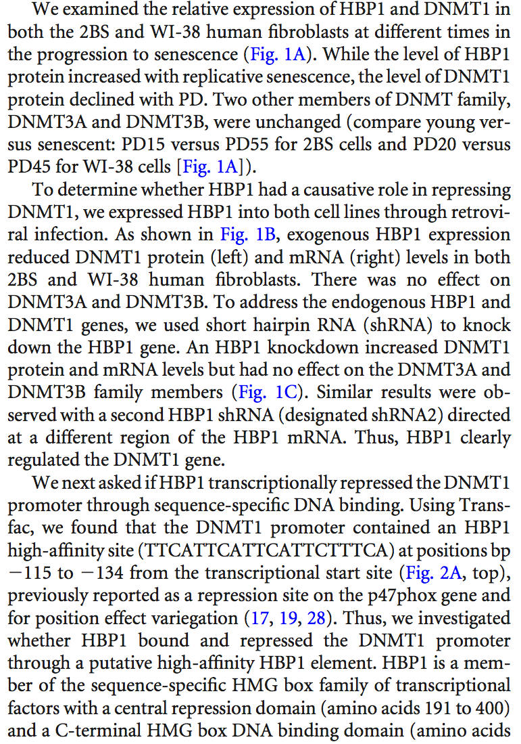
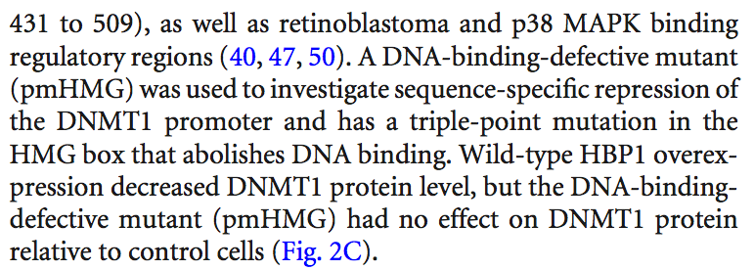
Pan et al. 2013, Experiments and Observations
Results
Background assertions + 35 small scale experiments (numbered by Figure: 1A-D, 2C-F, 3A-B,4A-E, 5A-D, 6A-F, 7A-E, 8A-D)
(2C) Expression of exogenous HBP1 decreases DNMT1 protein level. HEK293T cells were transfected with HA-HBP1 or HA-pmHMG. Western blotting was performed on protein lysates using anti-HA antisera, anti-DNMT1, or anti-GAPDH.
An example: Pan et al. 2013
☐☐☐ ☐☐☐☐☐ ☐☐ ☐☐☐ ☐ ☐☐

Slide 8
A Model of Pan et al. 2013, Fig 2C.
overexpress
this gene…
overexpress HBP1…
reduces DMNT1
measure protein
levels of this
molecule…
overexpress mutant with key sequence removed…
abolishes effect
An example: Pan et al. 2013
☐☐☐ ☐☐☐☐☐ ☐☐ ☐☐☐ ☐ ☐☐

Slide 9
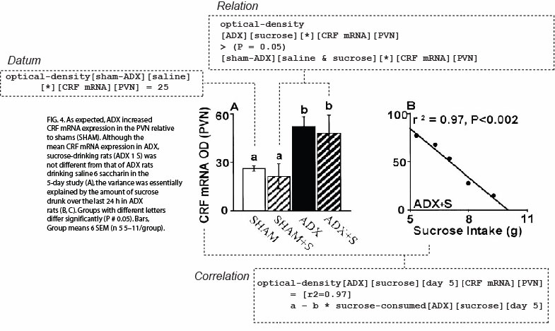
Data, Relations and Correlations are Statistical Effects
Laugero, et al. (2001) Endocrinology, 142(7): 2796-804
An example: Pan et al. 2013
☐☐☐ ☐☐☐☐☐ ☐☐ ☐☐☐ ☐ ☐☐
Notes:
Point is not the ontology itself, point is the function.

Slide 10
Preliminary KEfED Annotations in brat
Laugero, et al. (2001) Endocrinology, 142(7): 2796-804
An example: Pan et al. 2013
☐☐☐ ☐☐☐☐☐ ☐☐ ☐☐☐ ☐ ☐☐
Notes:
Point is not the ontology itself, point is the function.

Slide 11
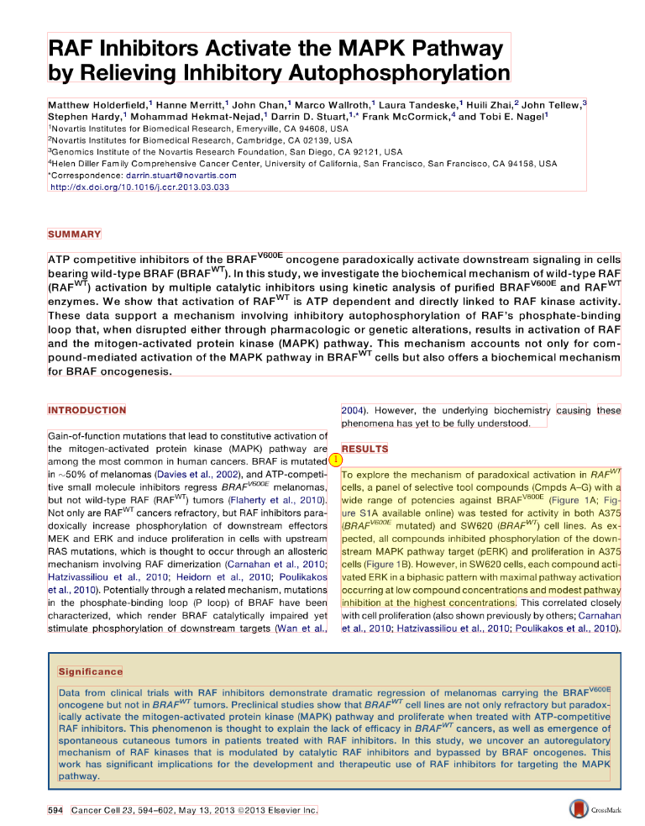
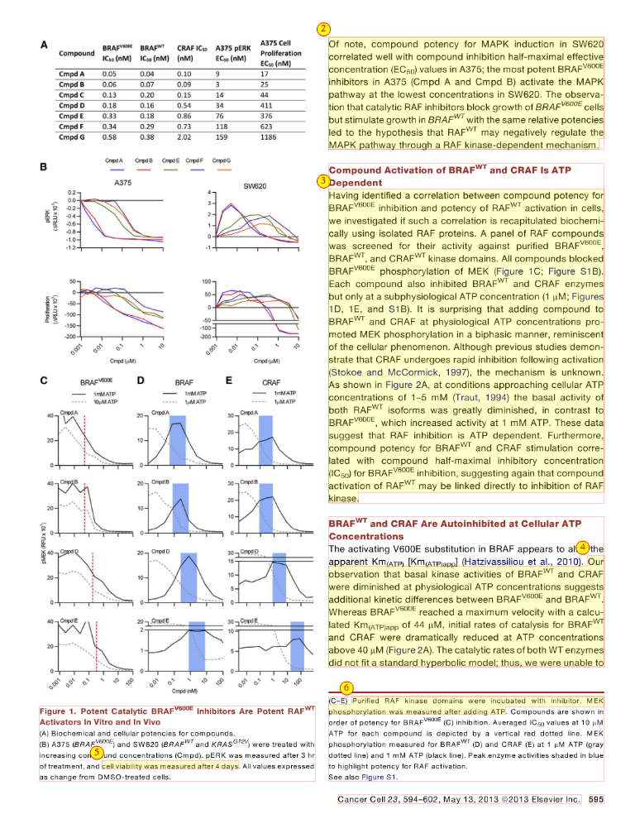
Holderfield et al. 2013
Not all sentences correspond to experimental claims
(16 experiments, 150 sentences)
11–13, 15–16
17–25, 27–34
35–37, 39
40–41, 46–47, 51–54
55
56–59, 61–64
60
65–67
68–70
71
72–73
74–77
81–84
86–87, 89
90–93
94–97, 99
Laugero, et al. (2001) Endocrinology, 142(7): 2796-804
An example: Holderfield et al. 2013
☐☐☐ ☐☐☐☐☐☐ ☐ ☐☐☐ ☐ ☐☐
Notes:
Point is not the ontology itself, point is the function.

Slide 12
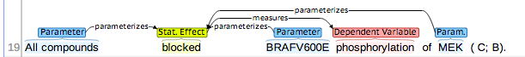
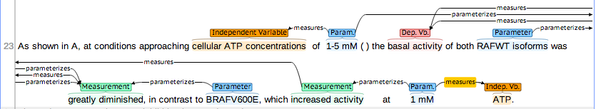
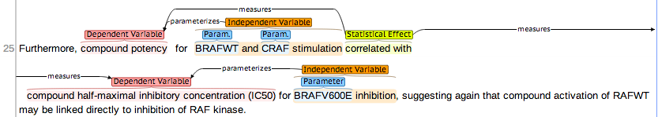
Preliminary KEfED Annotations of Holderfield et al. 2013 in brat
An example: Holderfield et al. 2013
☐☐☐ ☐☐☐☐☐☐ ☐ ☐☐☐ ☐ ☐☐
Notes:
Point is not the ontology itself, point is the function.

Slide 13
Previous implementation focused on precise definition of types
‘Ontology of Experimental Variables and Values’ (OoEVV)
http://bioportal.bioontology.org/ontologies/3006
Burns, G.A.P.C., Turner, J.A., Modeling functional Magnetic Resonance Imaging (fMRI) experimental variables in the Ontology of Experimental Variables and Values (OoEVV), NeuroImage (2013), http://dx.doi.org/10.1016/j.neuroimage.2013.05.024
KEfED annotations
☐☐☐ ☐☐☐☐☐☐ ☐☐ ☐☐ ☐ ☐☐
Notes:
Point is not the ontology itself, point is the function.

Slide 14
Preliminary KEfED Annotation Model – very lightweight types
‘cellular ATP
concentrations’
IndepVb
parameterizes
DepVb
measures
‘basal activity’
measures
1..*
Parameter
1
measures
‘1-5 mM’
parameterizes
Measurement
‘greatly diminished’
parameterizes
Statistical-Effect
‘increased’
‘had no effect’
‘correlates with’
KEfED annotations
☐☐☐ ☐☐☐☐☐☐ ☐☐ ☐☐ ☐ ☐☐
Notes:
Point is not the ontology itself, point is the function.

Slide 15
Reading KEfED: measurement variables indexed by parameter variables
Which sentences contain experimental text?
Need to segment text pertaining to separate experiments.
Representation centers around statistical effects
Core Annotation Model
IndepVb ← Param
DepVb ← Measurement / Statistical Effect
Generative model of experimental types
Experimental Design ➔ Template ➔ structured slots
NEED THE EXPERIMENTAL CONTEXT TO MAKE SENSE OF EXPERIMENTAL RESULTS!
KEfED annotations
☐☐☐ ☐☐☐☐☐☐ ☐☐ ☐☐ ☐ ☐☐

Slide 16
Document Management – Big Mechanism PMC Corpus
Input count from PMC id list: 1757
Unique ids: 840
PDF
PMC XML
Elsevier XML
Text
Annotations
Doc Management
☐☐☐ ☐☐☐☐☐☐ ☐☐ ☐☐☐  ☐☐

Slide 17
Open Questions
How to encode background knowledge as ‘types’ / ‘motifs’?
Key correspondence between complex structured entities and parameters in experiments
How to support reading using ML?
How to assemble KEfED-structured annotations into models?
KEfED / BioPAX / PL / BEL ?
Higher order ‘phenotype’ elements?
Open Questions
☐☐☐ ☐☐☐☐☐☐ ☐☐ ☐☐☐ ☐ ☐

Slide 18
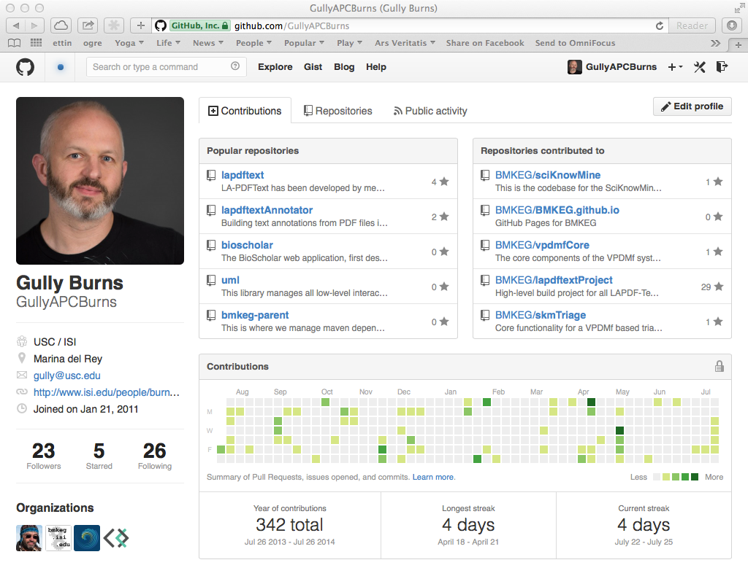
GitHub
‘Private’ repos for our data and code.
Can we please think of a better name than ‘reaper’?
Open Questions
☐☐☐ ☐☐☐☐☐☐ ☐☐ ☐☐☐ ☐ ☐
Notes:
Point is not the ontology itself, point is the function.

